Slide 1
Z Apocalypse
Rayan Syed & James Patrick Arellano

Slide 2
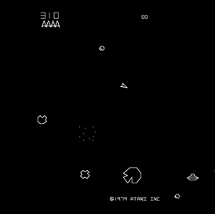

Introduction
Aim of the game
Character and enemies
Features of the game
Inspiration
Notes:
2

Slide 3
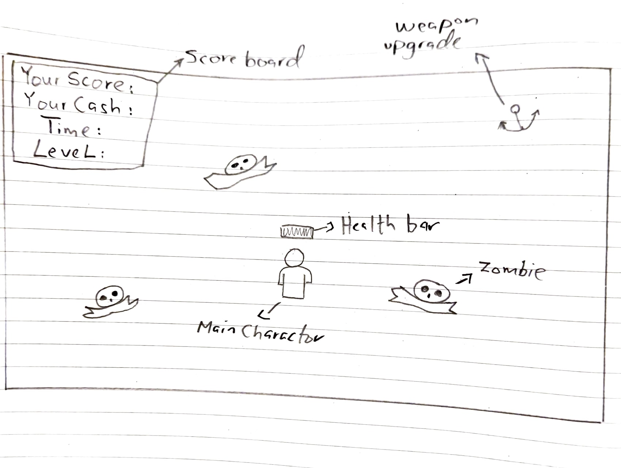
Design
Notes:
3

Slide 4

Development Process
Design Considerations
Deciding what type of game it is
What are the actors are
Scoring and rewards system
Different counters
When to change levels and the duration of each levels
Player’s and zombies’ health system
When to upgrade weapons

Slide 5

Contribution
James
Myworld class (the environment)
Counters class(score, cash and time)
Healthbar class (health system)
Rayan
Player class (main character’s movement controls and movement speed)
Projectile class (design of the gun’s bullet)
Weapon button class (upgrade functions)
Zombie class (design of the zombies)

Slide 6
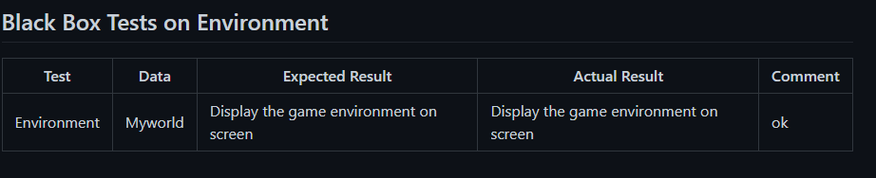
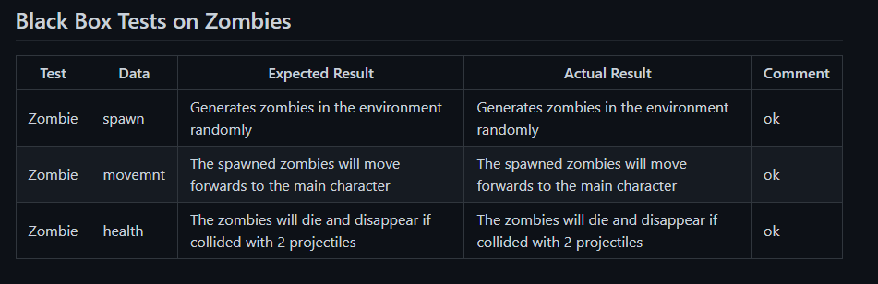
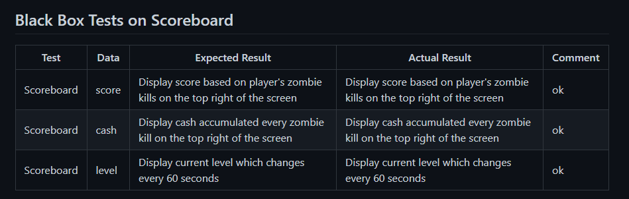
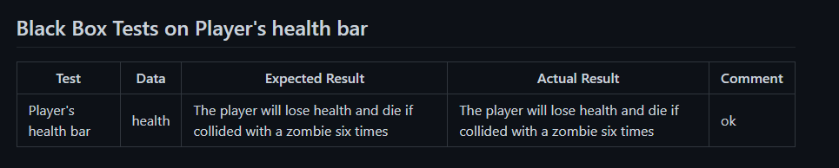
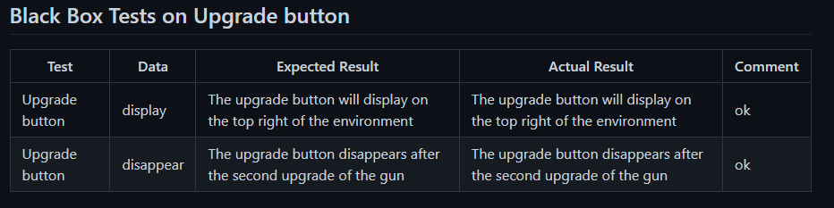
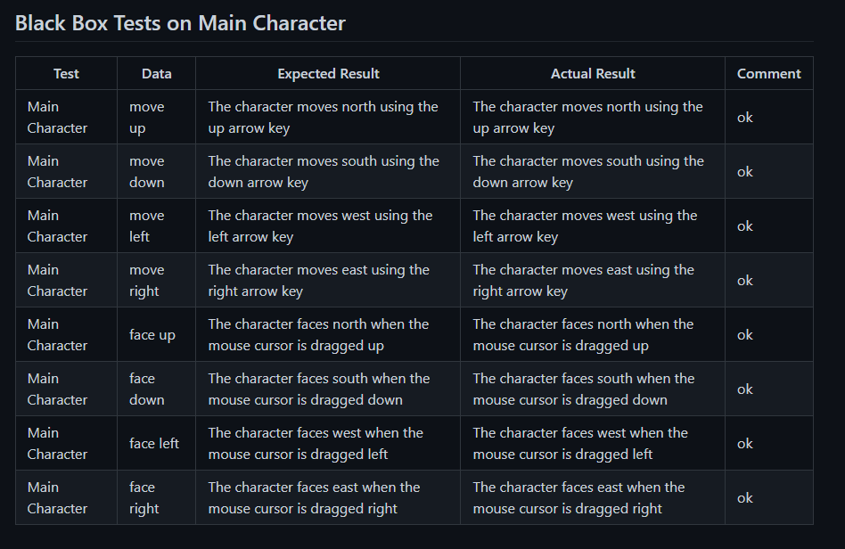
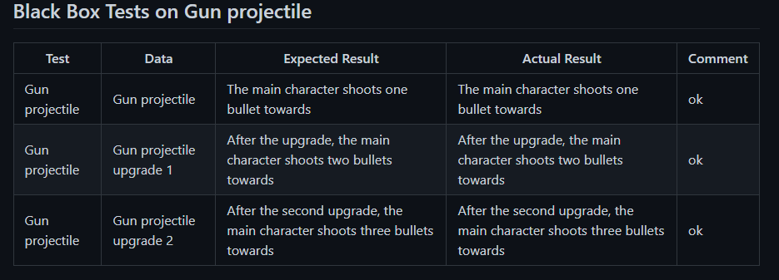
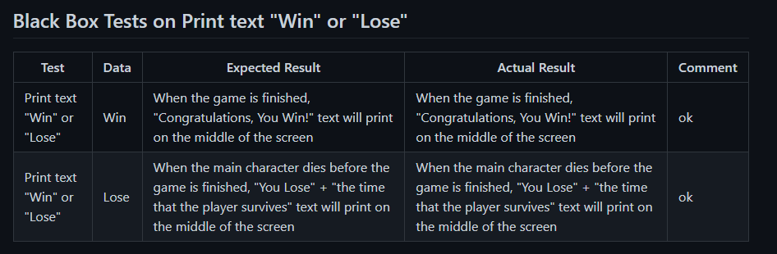
Testing

Slide 7
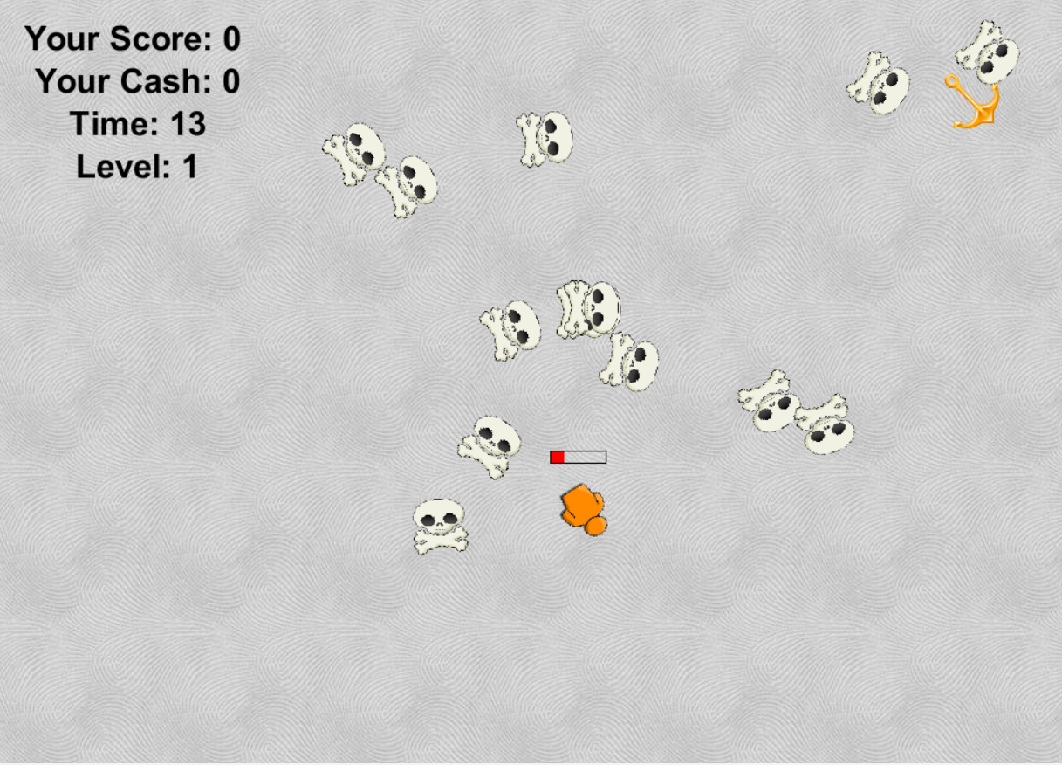
Demonstration
Notes:
7

Slide 8

Issues That occurred during the development Process
Dynamic Counters
Health Related Issues
Players Related Problems
Mouse Following Problems
Levels
Problems with Weapon Upgrade System
Notes:
8

Slide 9
Evaluation & Recommendation
Evaluation:
This assignment has helped us to learn a lot about game development and the tools which can be used for. Key highlights of learning can be summarized as:
Understanding of the Process:
New tools:
Solution Process:
FUTURE IMPROVEMENTS:
More accurate mouse-based actions
Sound effects
Change of screen or backgrounds
Adding multiple scenarios
Multiplayer
Notes:
9

